Slide 1

Crystal Advanced Analytics
Milestone 4
Harshil Haumeer

Slide 2
Client: Dr. Richard Griffith Department of Psychology Faculty Sponsor:
Dr. Philip Chan
Department of Computer Science

Slide 3
Progress of Current Milestone
Task | Completion | To do
Improve System accuracy (Classifier) | 100% | Classifier’s accuracy improved by 15%. Currently at 72.37% with NB, and 71.37% with decision tree classifier
Implement Benchmarking Tool | 40% | Complete implementation of benchmarking tool
Implement Dashboard on Website | 70% | Improve dashboard and implement graphs
Improve Website | 50% | Connect data to graphs, improve GUI

Slide 4
Discussion of each accomplished task for current milestone:
Task 1: Improve System Accuracy
System accuracy was improve by ~15%.
Naïve Bayes: 72.37%
Decision Tree: 71.37%
K-Neighbors: 69.31%
Linear SVC: 64.3%
Task 2: Implement Benchmarking Tool
Retrieved Data from different airports, JFK and HKG.
Convert reviews from non-English medium to English
Py-translate library
Task 3: Implementation of Dashboard
Dashboard was successfully implemented with different components
Service Overview
Benchmarking component

Slide 5
Discussion of each accomplished task for current milestone:
Task 4: Improve Website
Improved Home Page
Added drop-down menus
Investigated types of graphs for representing different types of data

Slide 6
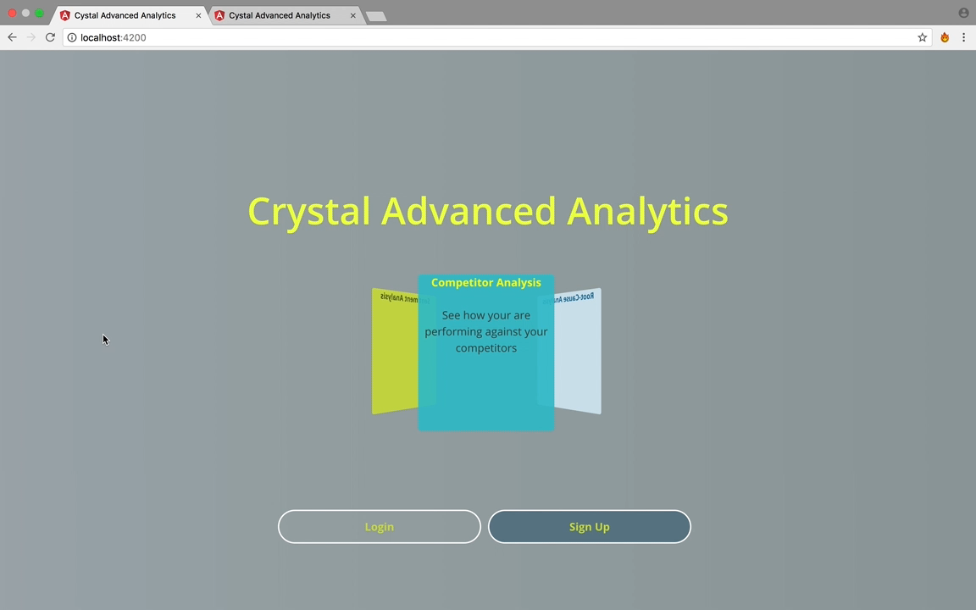
Demo : Home Page, Sign-in, Sign-up

Slide 7
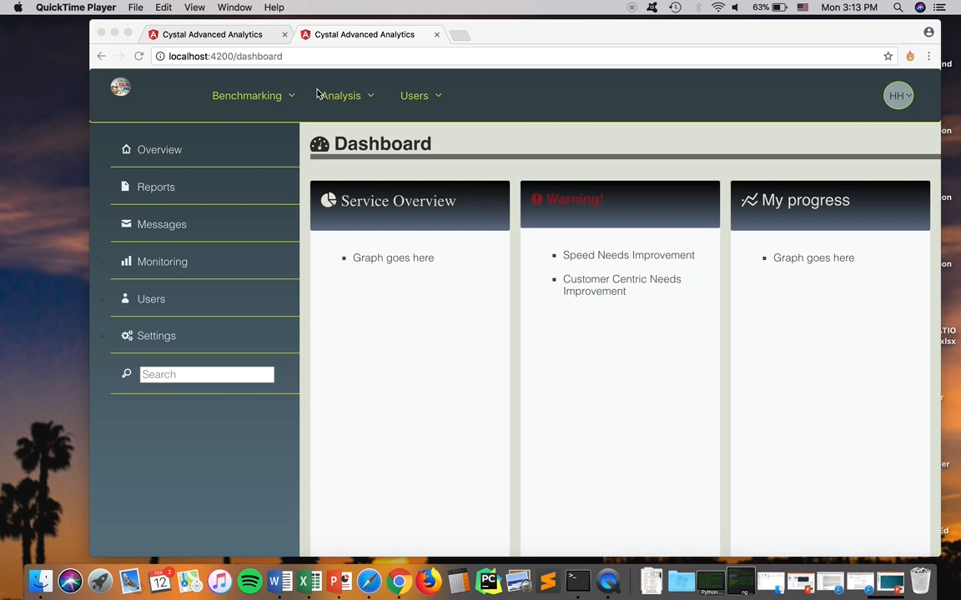
Demo : Dashboard

Slide 8
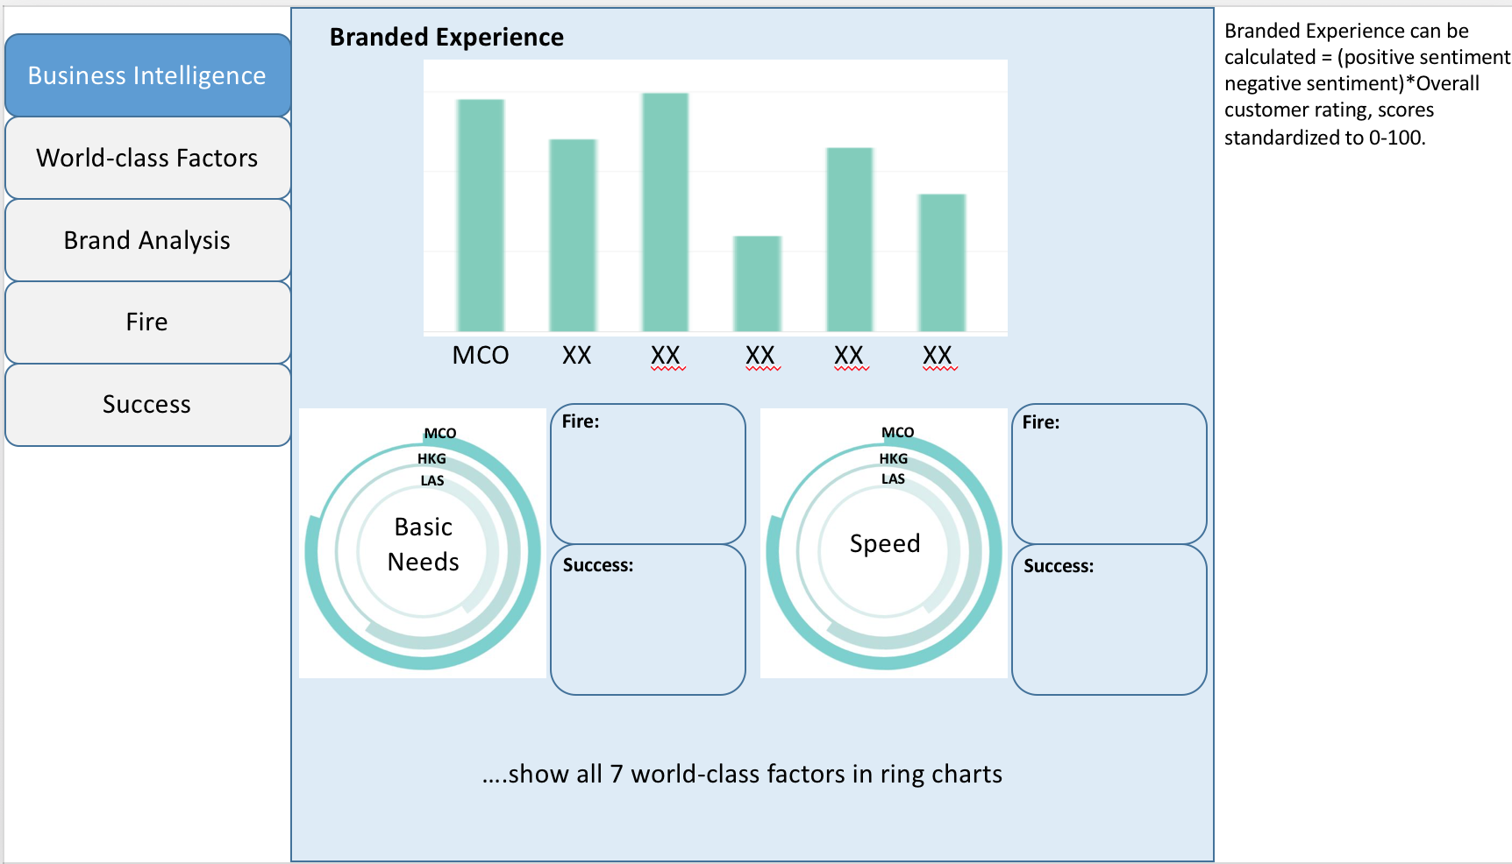
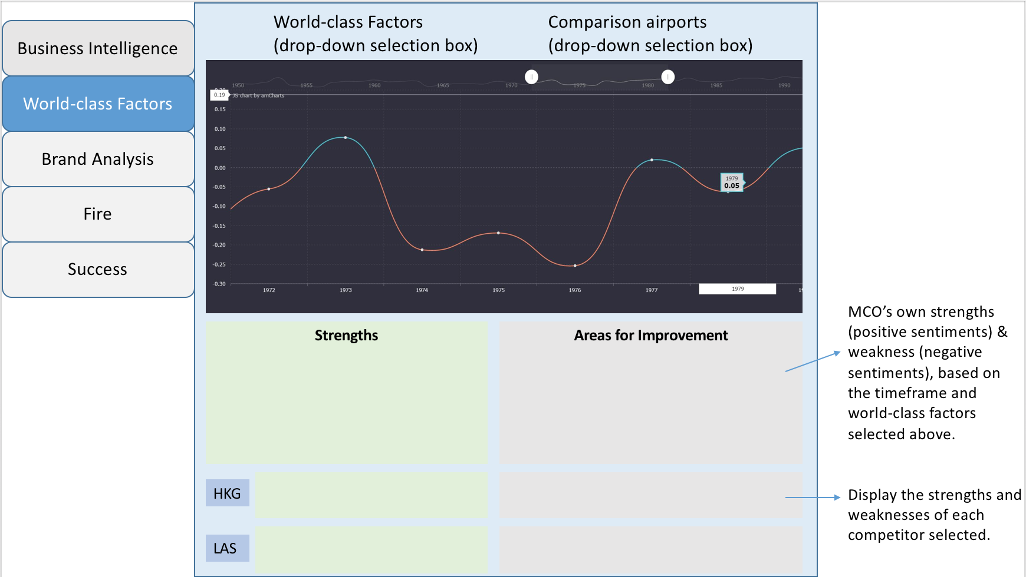
Mock-up : Dashboard

Slide 9
Plan for Next Milestone
Task | Harshil
Complete Implementation of Benchmarking Tool | 100%
Implement, Test and Demo Root-Cause Analysis | 100%
Implement graphs on Dashboard | 100%
Improve website | 100%
Showcase Poster | 100%

